Slide 1

Gen-AI

Slide 2
Day 3 - Python

Slide 3

Syllabus
Pre Training – Variables, Data Types, Operators
Training
1. Topics: Data Structures - Lists, dictionaries, tuples, and sets.
2. Hands-On: Create a contact book using dictionaries.
Post Training – Case Study: Build a to-do list application with list and dictionary functionalities.

Slide 4
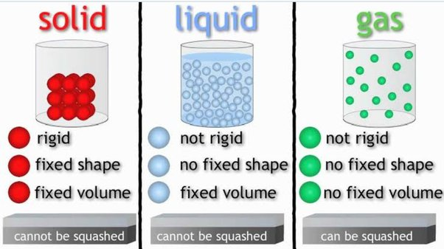
Matter exists in three states

Slide 5
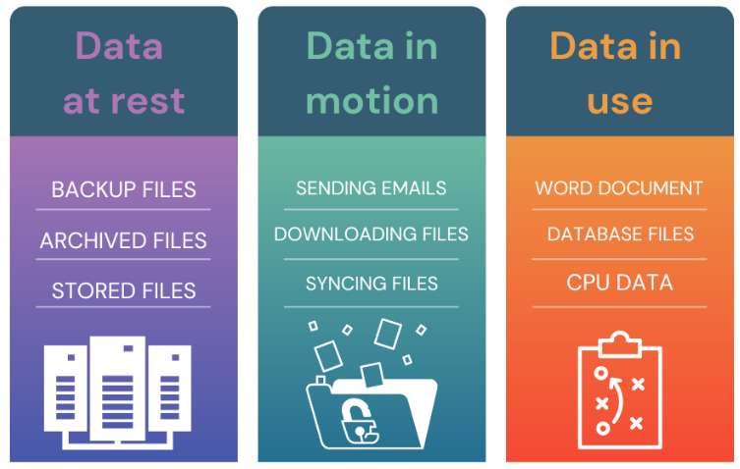
Data exists in three states

Slide 6
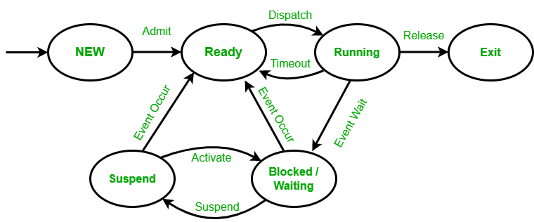
Process states

Slide 7
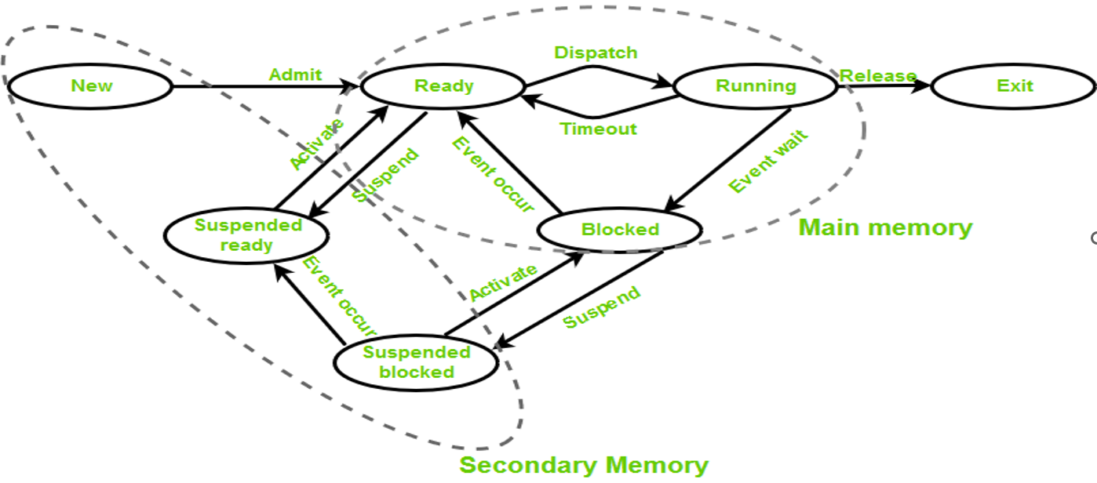
Process states with Data storage and access

Slide 8
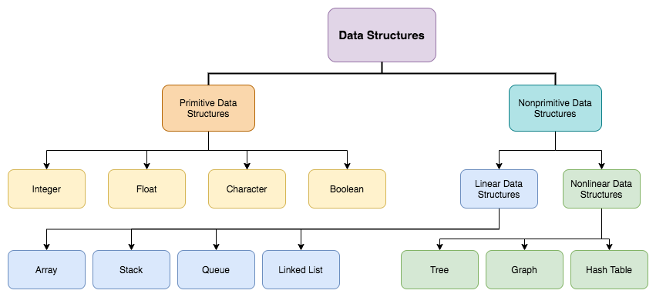
Types of Data Structures

Slide 9
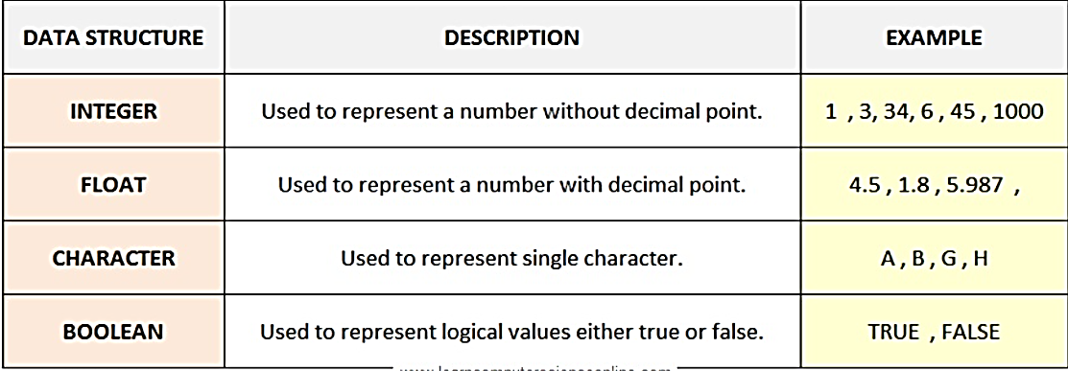
Primitive Data Structures

Slide 10
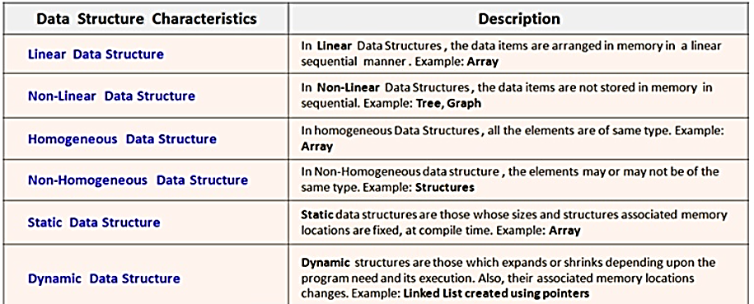
Non-Primitive Data Structures

Slide 11
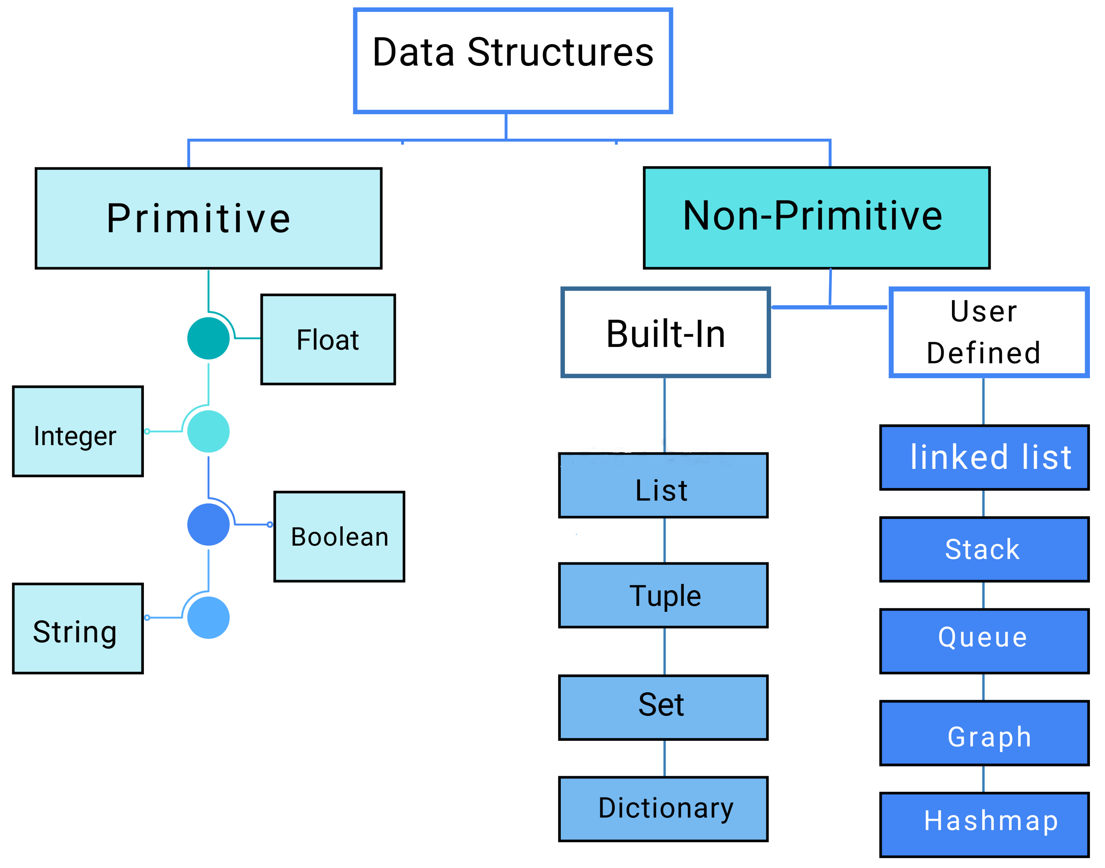
Types of Data Structures in Python

Slide 12
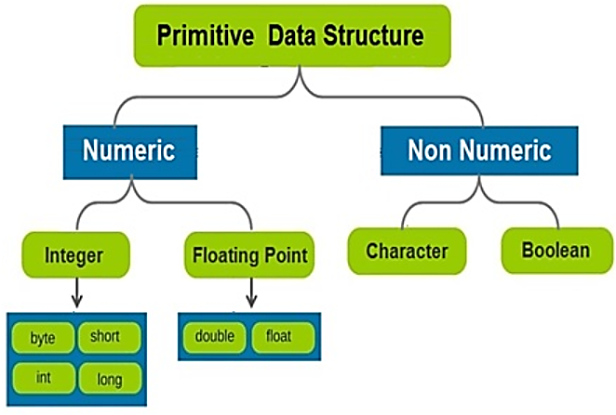
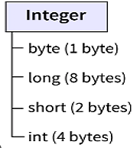
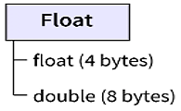
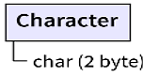
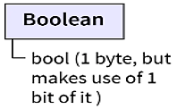
Primitive Data Structures in Python
Primitive data structures, are the fundamental data types that are built into programming languages and can be directly operated by the CPU using machine-level instructions on data stored in memory or registers.

Slide 13
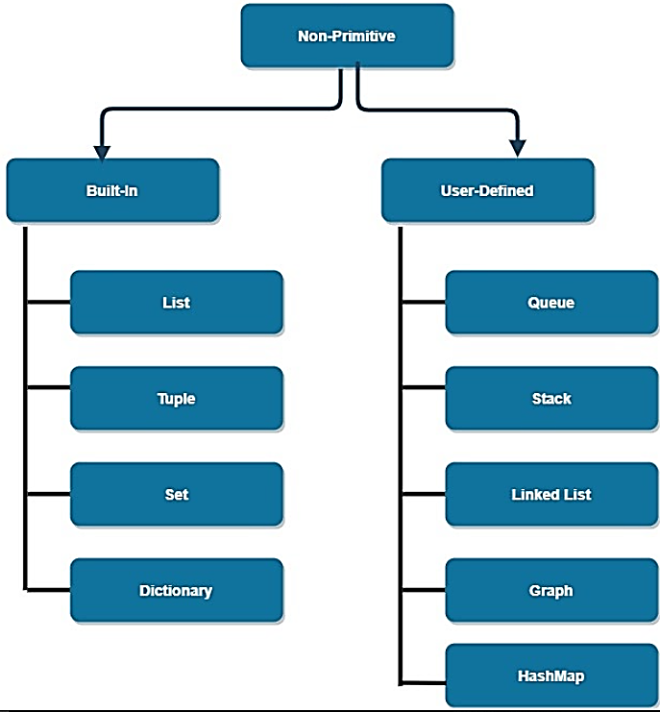
Non-Primitive Data Structures in Python
Non Primitive data structures, are built using the primitive data types
Operations on a Nonprimitive data structure are Insertion, Selection, Searching, Sorting, Merging, Traversal, and Deletion.

Slide 14
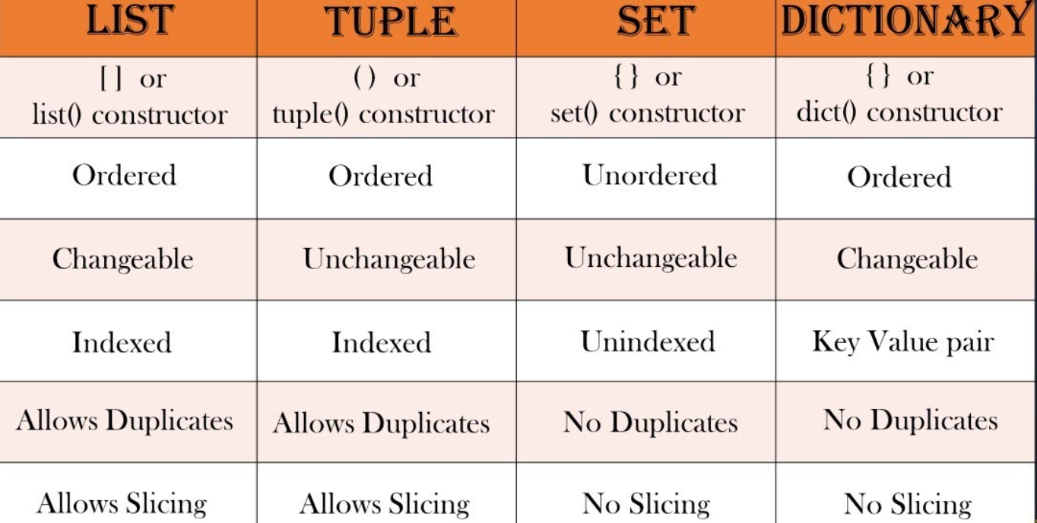
Types of inbuilt Data Structures in Python

Slide 15
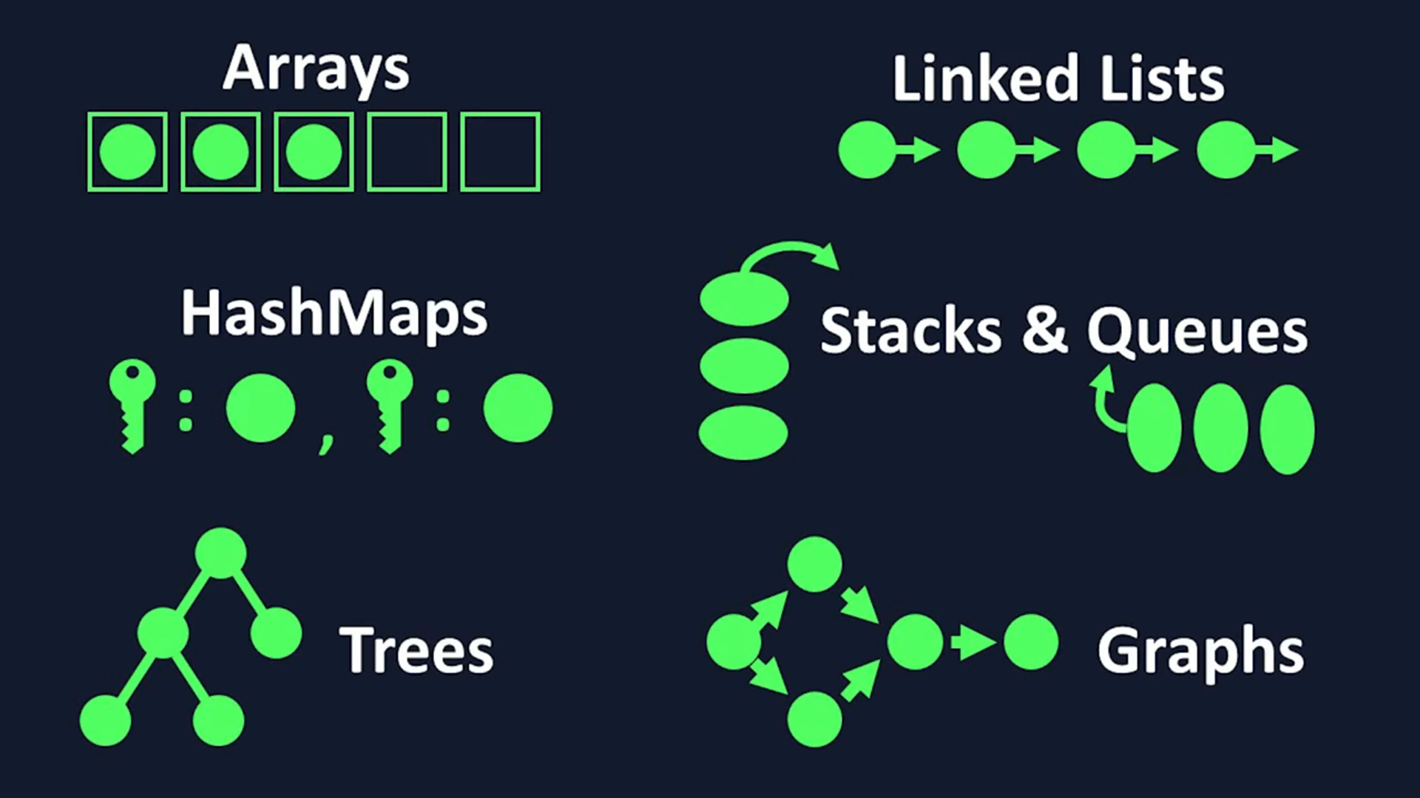
Diagrammatic representation of Data Structures

Slide 16
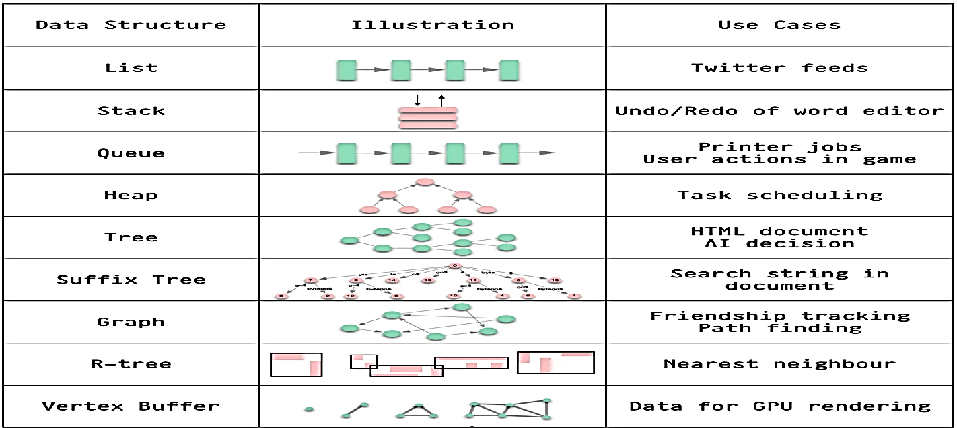
Use cases of various Data Structures

Slide 17
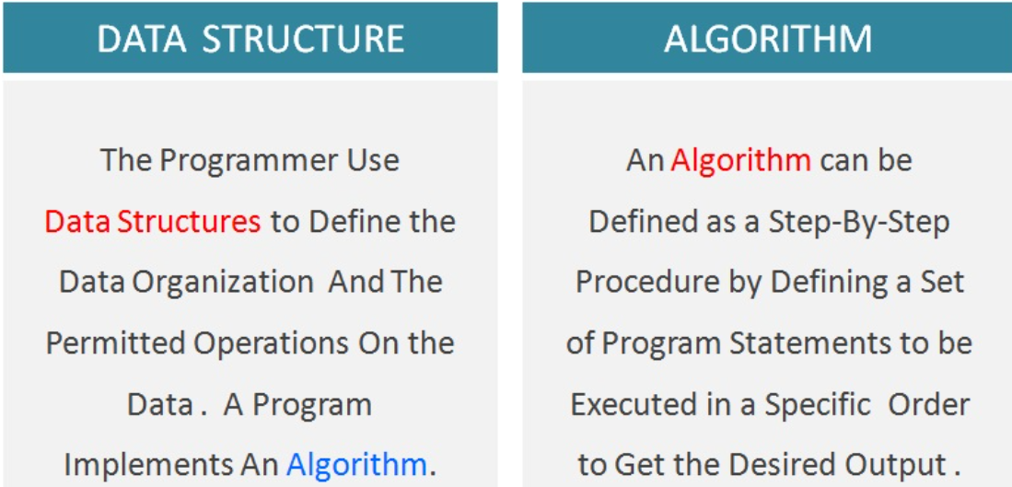
Data Structures vs Algorithm

Slide 18
Introduction and components of Data Structures
Data structures are fundamental building blocks used to store and organize data in computer memory for efficient storage, retrieval, and manipulation of information in various algorithms and applications
Data structures affect the design of both structural and functional aspects of a program. (Program = Algorithm + Data Structures)
Interface - Interface represents the set of operations that a data structure supports, type of parameters they can accept, and return type of these operations.
Implementation - Implementation provides the internal representation of a data structure. (Indexed, LIFO, FIFO, Branch). The implementation also defines the algorithms used in the operations of the data structure.

Slide 19
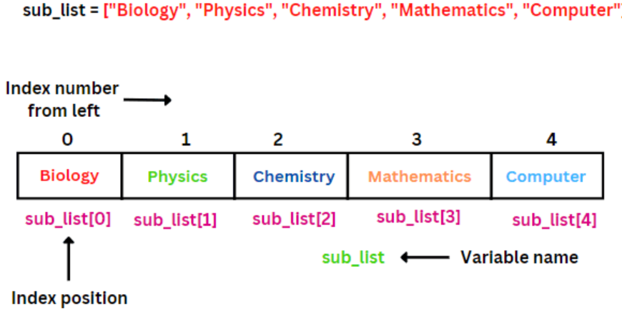
What is a List?, How is it stored in the memory?

Slide 20
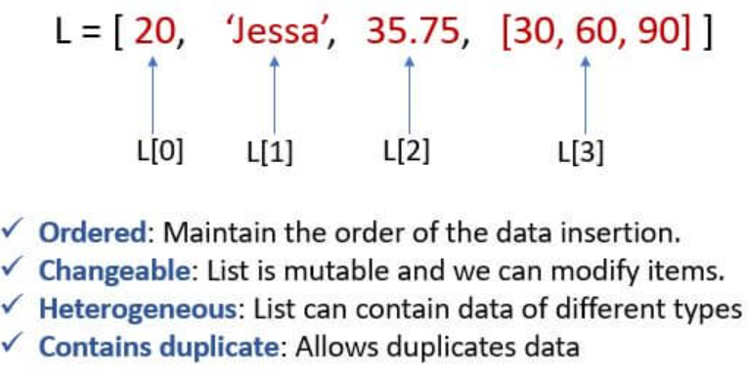
What is a List?, How is it stored in the memory?

Slide 21
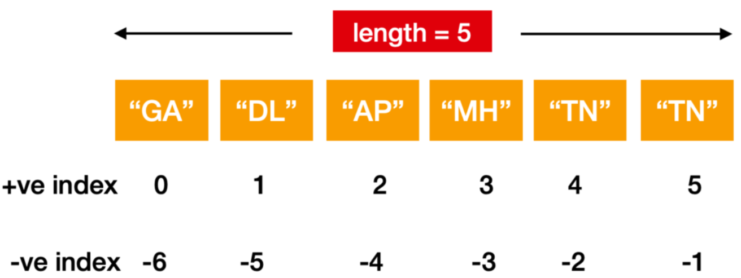
What is a List?, How is it stored in the memory?

Slide 22
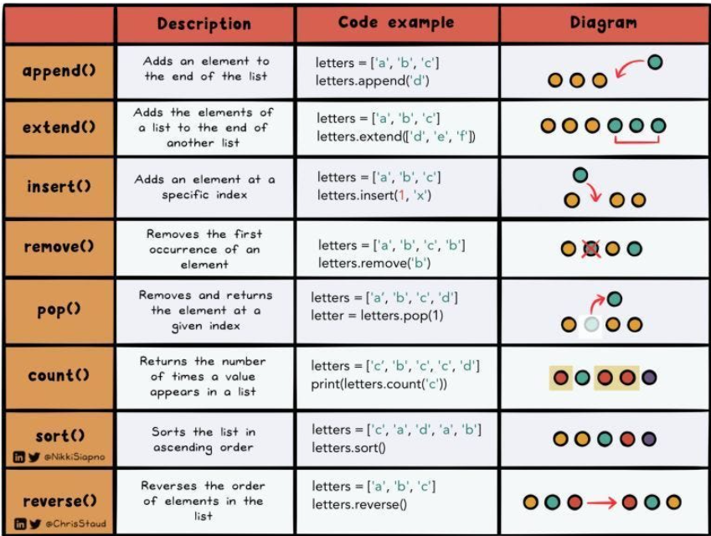
List Operations

Slide 23
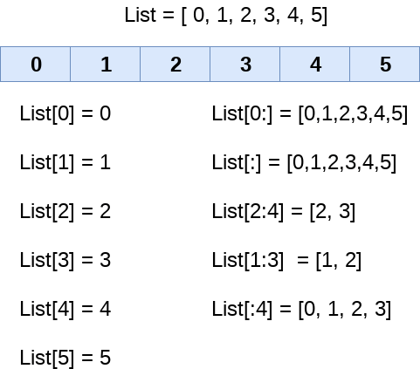
List Slicing Operations

Slide 24
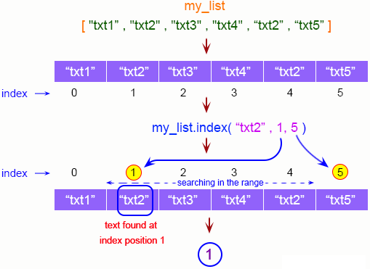
List Searching Operations

Slide 25
List Operations - 1
Accessing elements:
Accessing elements by index
Slicing lists to extract subsets of elements
Modifying elements:
Assigning new values to elements at specific indices
Appending elements:
Adding elements to the end of the list using methods like append()
Inserting elements:
Inserting elements at specific indices using methods like insert()
Removing elements:
Removing elements by value with remove() method
Removing elements by index with pop() method
Searching for elements:
Searching for elements witj index() methods
Sorting elements:
Sorting elements in ascending or descending order using methods like sort()

Slide 26
List Operations - 2
Iterating through elements:
Using loops (for, while) to iterate through list elements
Combining lists:
Concatenating or combining lists
Copying lists:
Creating copies of lists using methods like copy() or slicing
List comprehension:
Creating new lists based on existing lists using list comprehensions
List methods:
Utilizing various list methods such as count(), extend(), clear(), etc.
List membership:
Checking if an element is present in a list using “in” operator
List length:
Determining the length of a list using the len() function
List reversal:
Reversing the order of elements in a list using methods like reverse()

Slide 27
List Operations Code
# Create a sample list
my_list = [1, 2, 3, 4, 5, 3, 6]
# Accessing elements
print("Accessing elements:")
print("First element:", my_list[0])
print("Last element:", my_list[-1])
print("Slicing list:", my_list[1:4]) # Slicing from index 1 to 3
# Modifying elements
print("\nModifying elements:")
my_list[2] = 10
print("Modified list:", my_list)
# Appending elements
print("\nAppending elements:")
my_list.append(7)
print("Appended list:", my_list)
# Inserting elements
print("\nInserting elements:")
my_list.insert(2, 8) # Inserting 8 at index 2
print("Inserted list:", my_list)
# Removing elements
print("\nRemoving elements:")
my_list.remove(3) # Removing element 3
print("List after removing element 3:", my_list)
popped_element = my_list.pop(1) # Removing element at index 1
print("Popped element:", popped_element)
print("List after popping element at index 1:", my_list)
# Searching for elements
print("\nSearching for elements:")
print("Index of element 5:", my_list.index(5))
# Sorting elements
print("\nSorting elements:")
my_list.sort()
print("Sorted list:", my_list)
# Iterating through elements
print("\nIterating through elements:")
for element in my_list:
print(element)
# Combining lists
print("\nCombining lists:")
new_list = [9, 10, 11]
combined_list = my_list + new_list
print("Combined list:", combined_list)
# Copying lists
print("\nCopying lists:")
copied_list = my_list.copy()
print("Copied list:", copied_list)
# List comprehension
print("\nList comprehension:")
squared_list = [x ** 2 for x in my_list]
print("Squared list:", squared_list)
# List methods
print("\nList methods:")
print("Count of 3 in list:", my_list.count(3))
my_list.extend([12, 13]) # Extending list with elements
print("Extended list:", my_list)
my_list.clear() # Clearing the list
print("Cleared list:", my_list)
# List membership
print("\nList membership:")
print("Is 5 in the list?", 5 in copied_list)
# List length
print("\nList length:")
print("Length of the list:", len(copied_list))
# List reversal
print("\nList reversal:")
copied_list.reverse()
print("Reversed list:", copied_list)

Slide 28
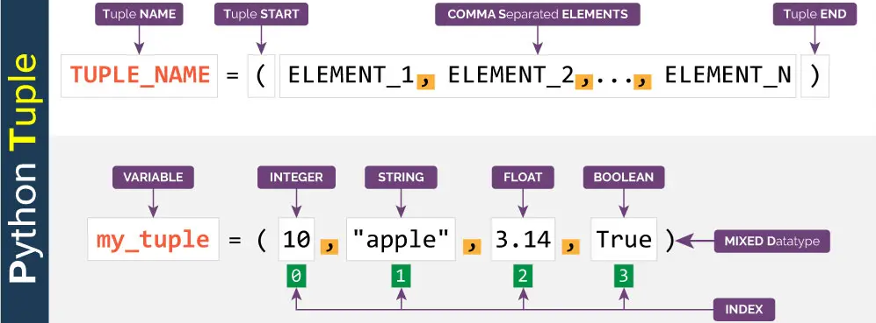
What is a Tuple

Slide 29
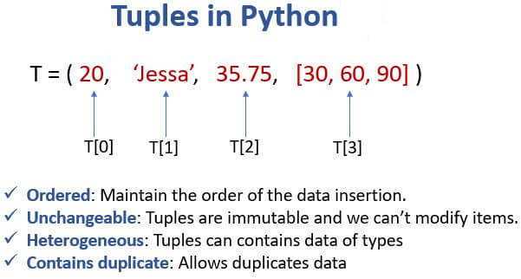
Tuple

Slide 30
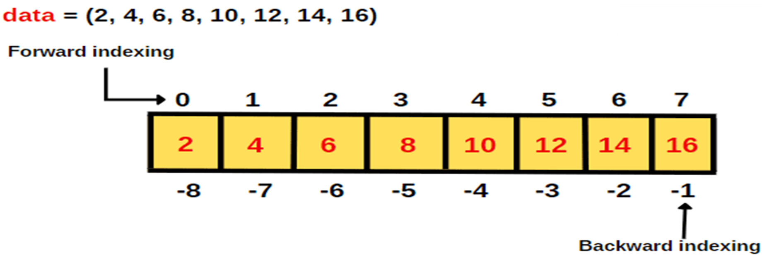
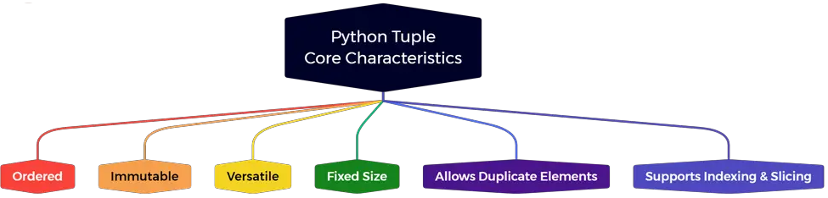
Indexing in Tuple

Slide 31
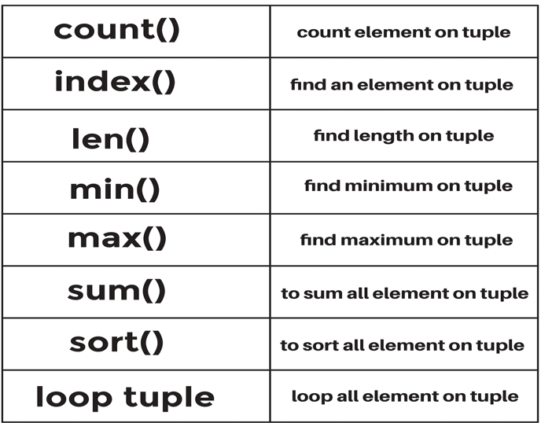
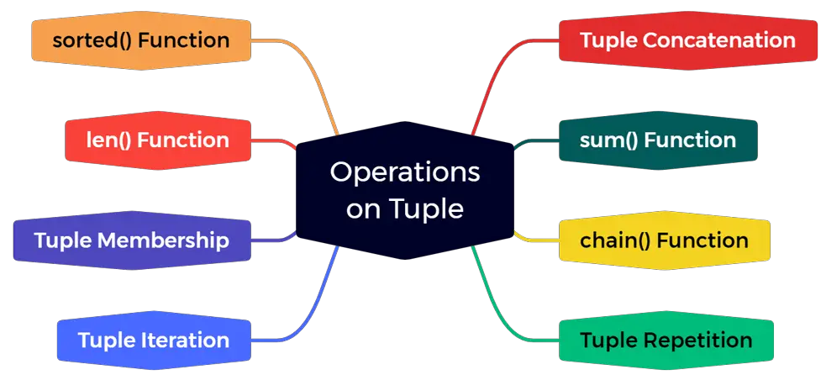
Tuple Operations

Slide 32
Tuples Operations - 1
Accessing elements:
Accessing elements by index, Slicing tuples to extract subsets of elements
Tuple unpacking:
Unpacking tuples to assign multiple variables at once
Immutable nature:
Tuples are immutable, meaning elements cannot be changed once defined
Concatenation:
Combining tuples using the + operator
Repetition:
Creating a new tuple by repeating elements using the * operator
Length determination:
Determining the length of a tuple using the len() function
Membership testing:
Checking if an element is present in a tuple using the ”in” operator
Using loops (for, while) to iterate through tuple elements
Counting occurrences:
Counting the number of occurrences of a specific element with count() method

Slide 33
Tuples Operations - 2
Finding index:
Finding the index of the first occurrence of a specific element with index() method
Tuple methods:
Utilizing various tuple methods such as index() and count()
Conversion:
Converting tuples to other data structures using list() or vice versa tuple()
Comparisons:
Comparing tuples using comparison operators like ==, !=, <, <=, >, >=
Sorting:
Sorting tuples using the sorted() function to return a sorted list
Hashing:
Tuples are hashable, they can be used as keys in dictionaries or elements in sets

Slide 34
Tuples Operations Code
# Create a sample tuple
my_tuple = (1, 2, 3, 4, 5, 3, 6)
# Accessing elements
print("Accessing elements:")
print("First element:", my_tuple[0])
print("Last element:", my_tuple[-1])
print("Slicing tuple:", my_tuple[1:4]) # Slicing from index 1 to 3
# Tuple unpacking
print("\nTuple unpacking:")
a, b, c, d, e, f, g = my_tuple
print("Unpacked elements:", a, b, c, d, e, f, g)
# Immutable nature
# Uncommenting the line below will raise an error since tuples are immutable
# my_tuple[0] = 10
# Concatenation
print("\nConcatenation:")
new_tuple = my_tuple + (7, 8, 9)
print("Concatenated tuple:", new_tuple)
# Repetition
print("\nRepetition:")
repeated_tuple = my_tuple * 2
print("Repeated tuple:", repeated_tuple)
# Length determination
print("\nLength determination:")
print("Length of the tuple:", len(my_tuple))
# Membership testing
print("\nMembership testing:")
print("Is 5 in the tuple?", 5 in my_tuple)
# Iterating through elements
print("\nIterating through elements:")
for element in my_tuple:
print(element)
# Counting occurrences
print("\nCounting occurrences:")
print("Count of 3 in tuple:", my_tuple.count(3))
# Finding index
print("\nFinding index:")
print("Index of 5 in tuple:", my_tuple.index(5))
# Tuple methods
# Tuples have only two methods: count() and index()
# You can see the usage of count() and index() in the previous examples
# Conversion
print("\nConversion:")
list_from_tuple = list(my_tuple)
print("Converted to list:", list_from_tuple)
# Comparisons
print("\nComparisons:")
tuple1 = (1, 2, 3)
tuple2 = (1, 2, 4)
print("Tuple 1 == Tuple 2?", tuple1 == tuple2)
print("Tuple 1 < Tuple 2?", tuple1 < tuple2)
# Sorting
print("\nSorting:")
sorted_tuple = sorted(my_tuple)
print("Sorted tuple:", sorted_tuple)
# Hashing
print("\nHashing:")
my_dict = {}
my_dict[my_tuple] = "This is a tuple"
print("Dictionary with tuple key:", my_dict)

Slide 35
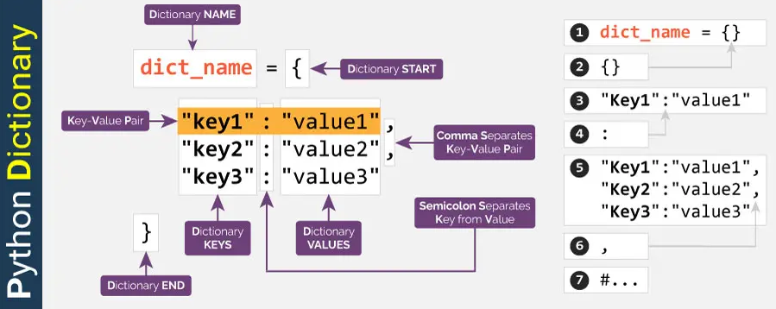
What is a Dictionary

Slide 36
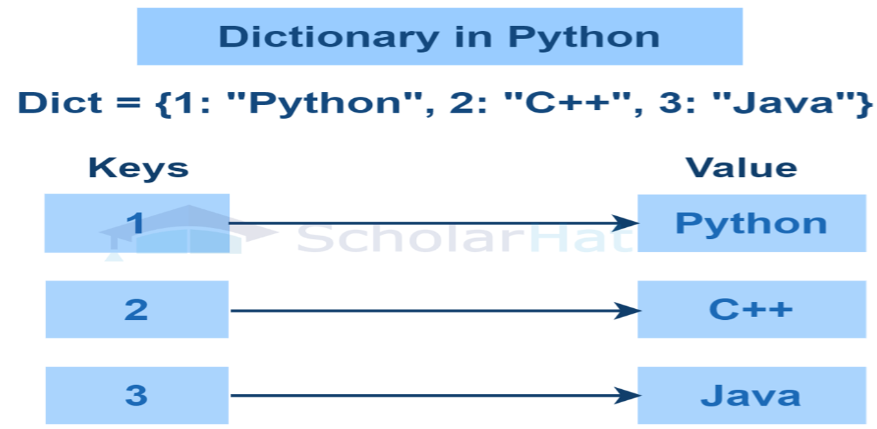
Dictionary in Python

Slide 37
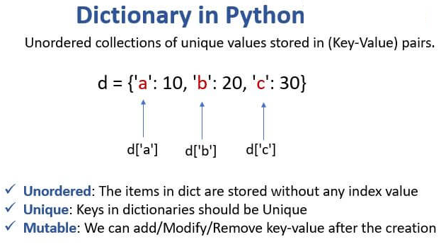
Dictionary in Python

Slide 38
Dictionary Operations – 1
Accessing elements:
Accessing values using keys
Adding and updating elements:
Adding new key-value pairs to the dictionary
Updating existing values associated with keys
Removing elements:
Removing key-value pairs from the dictionary using methods like del, pop(), popitem()
Checking membership:
Checking if a key exists in the dictionary using the in and not in operators
Iterating through elements:
Iterating through keys, values, or key-value pairs using loops (for) or dictionary methods
Getting keys, values, and items:
Retrieving keys, values, or items (key-value pairs) as iterable objects using methods like keys(), values(), items()
Length determination:
Determining the number of key-value pairs in the dictionary using the len() function
Clearing the dictionary:
Removing all key-value pairs from the dictionary using the clear() method

Slide 39
Dictionary Operations - 2
Copying the dictionary:
Creating a shallow copy or deep copy of the dictionary using methods like copy(), dict()
Merging dictionaries:
Merging two dictionaries using the update() method or dictionary unpacking (** operator)
Dictionary comprehension:
Creating new dictionaries based on existing dictionaries using dictionary comprehension
Dictionary methods:
Utilizing various dictionary methods such as get(), setdefault(), fromkeys(), etc.
Dictionary views:
Getting dynamic views of dictionary keys, values, or items using methods like keys(), values(), items()
Key immutability:
Keys in a dictionary must be immutable types like strings, numbers, or tuples
Key uniqueness:
Ensuring that each key in a dictionary is unique; if you assign a new value to an existing key, it will overwrite the previous value

Slide 40
Dictionary Operations Code
# Create a sample dictionary
my_dict = {'name': 'John', 'age': 30, 'city': 'New York'}
# Accessing elements
print("Accessing elements:")
print("Name:", my_dict['name'])
print("Age:", my_dict['age'])
print("City:", my_dict['city'])
# Adding and updating elements
print("\nAdding and updating elements:")
my_dict['email'] = 'john@example.com'
print("Updated dictionary:", my_dict)
my_dict['age'] = 35
print("Updated age:", my_dict['age'])
# Removing elements
print("\nRemoving elements:")
del my_dict['city']
print("Dictionary after removing 'city' key:", my_dict)
popped_item = my_dict.pop('email')
print("Popped item:", popped_item)
print("Dictionary after popping 'email' key:", my_dict)
popped_item = my_dict.popitem() # Removes and returns an arbitrary (key, value) pair
print("Popped item (popitem()):", popped_item)
print("Dictionary after popping an arbitrary item:", my_dict)
# Checking membership
print("\nChecking membership:")
print("'name' in my_dict?", 'name' in my_dict)
print("'age' not in my_dict?", 'age' not in my_dict)
# Iterating through elements
print("\nIterating through elements:")
for key in my_dict:
print(key, ":", my_dict[key])
# Getting keys, values, and items
print("\nGetting keys, values, and items:")
print("Keys:", my_dict.keys())
print("Values:", my_dict.values())
print("Items:", my_dict.items())
# Length determination
print("\nLength determination:")
print("Length of the dictionary:", len(my_dict))
# Clearing the dictionary
print("\nClearing the dictionary:")
my_dict.clear()
print("Cleared dictionary:", my_dict)
# Copying the dictionary
print("\nCopying the dictionary:")
my_dict = {'name': 'John', 'age': 30, 'city': 'New York'}
copied_dict = my_dict.copy()
print("Copied dictionary:", copied_dict)
# Merging dictionaries
print("\nMerging dictionaries:")
additional_info = {'email': 'john@example.com', 'phone': '123-456-7890'}
my_dict.update(additional_info)
print("Merged dictionary:", my_dict)
# Dictionary comprehension
print("\nDictionary comprehension:")
square_dict = {num: num ** 2 for num in range(1, 6)}
print("Squared dictionary:", square_dict)
# Dictionary methods
print("\nDictionary methods:")
print("Value for 'name' key:", my_dict.get('name'))
print("Setting default value for 'gender' key:", my_dict.setdefault('gender', 'male'))
print("Dictionary after setdefault():", my_dict)
print("Creating a dictionary from keys:", dict.fromkeys(['a', 'b', 'c'], 0))
# Dictionary views
print("\nDictionary views:")
print("Keys view:", my_dict.keys())
print("Values view:", my_dict.values())
print("Items view:", my_dict.items())

Slide 41
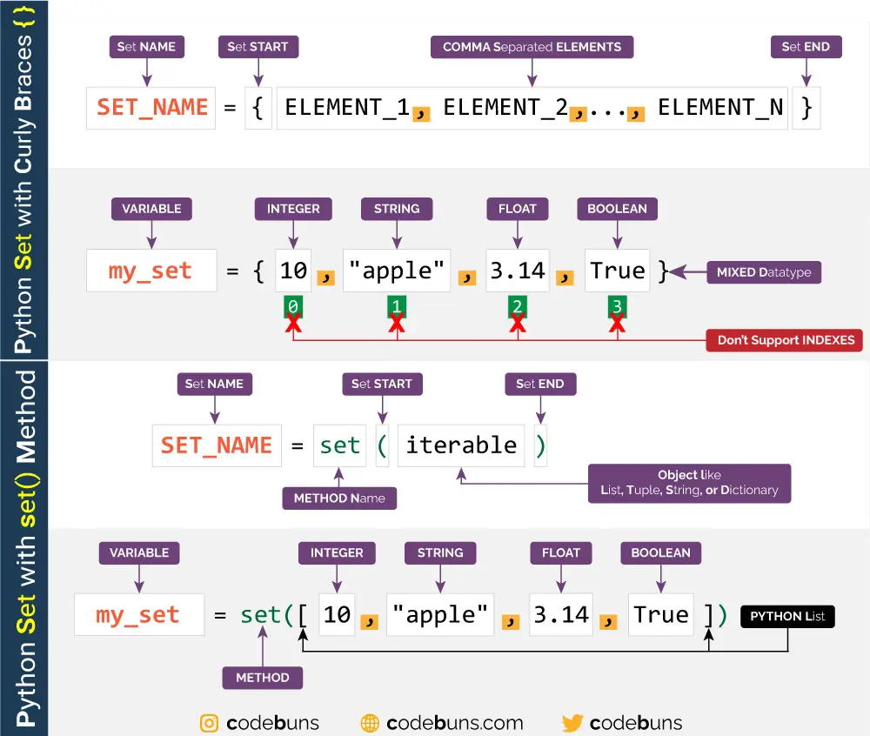
What is a Python Set

Slide 42
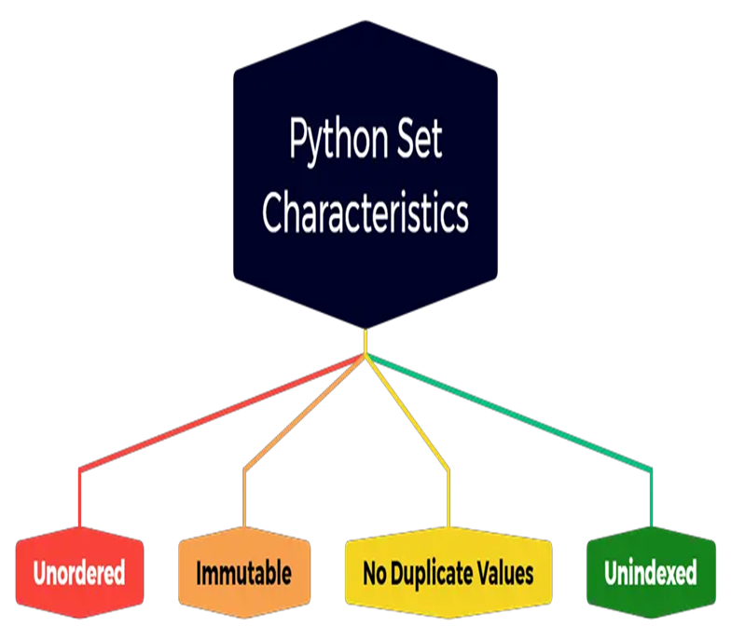
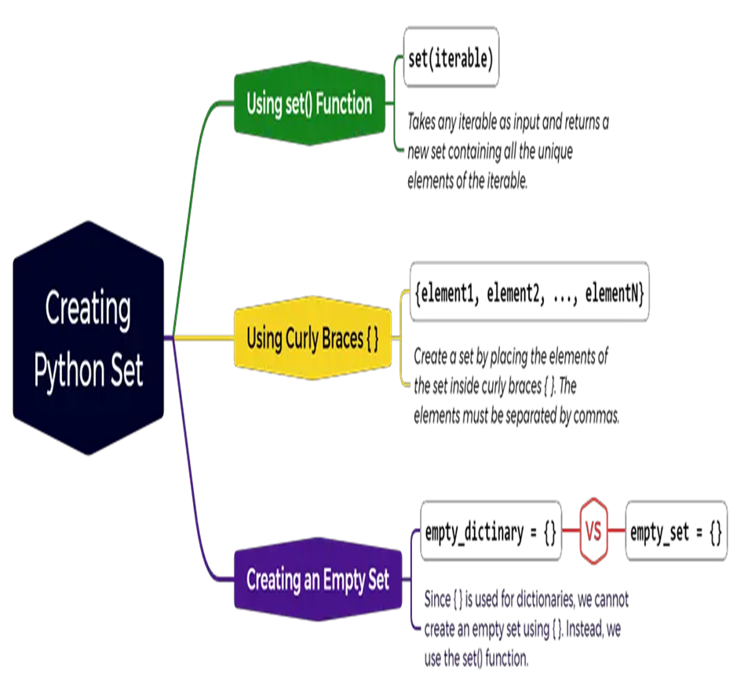
Key features of Python Set

Slide 43
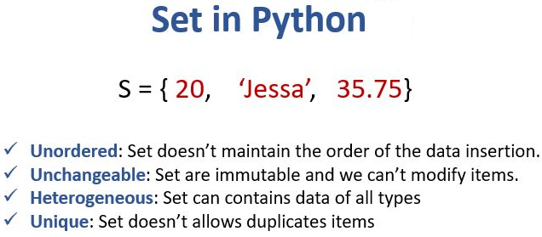
Sets in Python

Slide 44
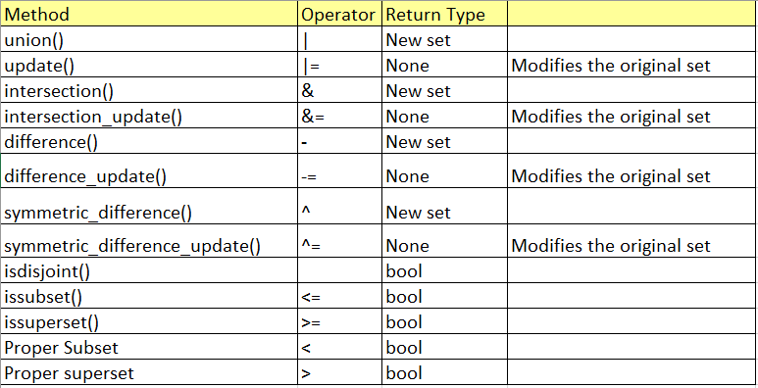
Set operations in Python

Slide 45
Set Operations -1
Adding elements:
Adding a single element to a set using the add() method
Adding multiple elements to a set using the update() method
Removing elements:
Removing a specific element from a set using the remove() method
Removing a specific element from a set if it is present, without raising an error, using the discard() method
Removing and returning an arbitrary element from a set using the pop() method
Removing all elements from a set using the clear() method
Checking membership:
Checking if an element is present in a set using the in and not in operators
Length determination:
Determining the number of elements in a set using the len() function
Set operations:
Union: Combining two sets to create a new set containing all unique elements using the union() method or the | operator
Intersection: Creating a new set containing elements common to both sets using the intersection() method or the & operator
Difference: Creating a new set containing elements present in the first set but not in the second set using the difference() method or the - operator
Symmetric difference: Creating a new set containing elements present in either set but not in both sets using the symmetric_difference() method or the ^ operator

Slide 46
Set Operations -2
Subset and superset checking:
Checking if one set is a subset of another set using the issubset() method or the <= operator
Checking if one set is a superset of another set using the issuperset() method or the >= operator
Disjoint checking:
Checking if two sets have no common elements, i.e., they are disjoint, using the isdisjoint() method
Copying sets:
Creating a shallow copy of a set using the copy() method
Converting from other data types:
Creating a set from a list, tuple, or any iterable using the set() constructor
Set comprehension:
Creating new sets based on existing sets or other iterables using set comprehensions
Frozen sets:
Immutable sets that do not allow modification of elements after creation

Slide 47
Basic Set Operations Code
# Creating sample sets
set1 = {1, 2, 3, 4, 5}
set2 = {4, 5, 6, 7, 8}
# Adding elements
print("Adding elements:")
set1.add(6)
print("After adding element 6 to set1:", set1)
set1.update({7, 8, 9})
print("After updating set1 with elements 7, 8, 9:", set1)
# Removing elements
print("\nRemoving elements:")
set1.remove(6)
print("After removing element 6 from set1:", set1)
set1.discard(9)
print("After discarding element 9 from set1:", set1)
popped_element = set1.pop()
print("Popped element from set1:", popped_element)
print("Set1 after popping an arbitrary element:", set1)
set1.clear()
print("Cleared set1:", set1)
# Checking membership
print("\nChecking membership:")
print("Is 5 in set2?", 5 in set2)
print("Is 3 not in set2?", 3 not in set2)
# Length determination
print("\nLength determination:")
print("Length of set2:", len(set2))
# Set operations
print("\nSet operations:")
print("Union of set1 and set2:", set1.union(set2))
print("Intersection of set1 and set2:", set1.intersection(set2))
print("Difference of set1 and set2:", set1.difference(set2))
print("Symmetric difference of set1 and set2:", set1.symmetric_difference(set2))
# Subset and superset checking
print("\nSubset and superset checking:")
print("Is set1 a subset of set2?", set1.issubset(set2))
print("Is set2 a superset of set1?", set2.issuperset(set1))
# Disjoint checking
print("\nDisjoint checking:")
set3 = {9, 10, 11}
print("Are set1 and set3 disjoint?", set1.isdisjoint(set3))
# Copying sets
print("\nCopying sets:")
copied_set2 = set2.copy()
print("Copied set2:", copied_set2)
# Converting from other data types
print("\nConverting from other data types:")
my_list = [1, 2, 3, 4, 5]
set_from_list = set(my_list)
print("Set from list:", set_from_list)
# Set comprehension
print("\nSet comprehension:")
squared_set = {x ** 2 for x in set_from_list}
print("Squared set:", squared_set)
# Frozen sets
frozen_set = frozenset(set_from_list)
print("\nFrozen set:", frozen_set)

Slide 48
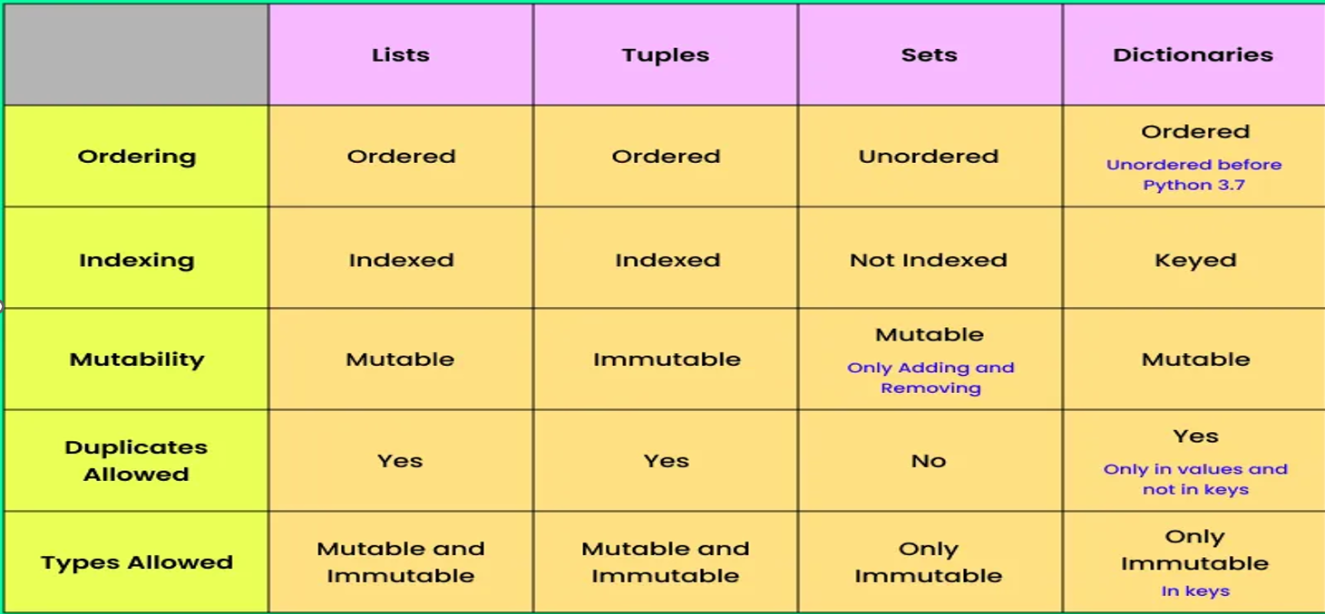
List vs Tuple vs Set vs Dictionary

Slide 49
Handson – Contact book
def contact_book():
print("Welcome to the Simple Contact Book!")
contacts = {} # Dictionary to store contacts
while True:
# Display menu
print("\nMenu:")
print("1. Add a Contact")
print("2. View a Contact")
print("3. View All Contacts")
print("4. Delete a Contact")
print("5. Update a Contact")
print("6. Quit")
# Get user choice
choice = input("Enter your choice (1/2/3/4/5/6): ")
if choice == '1':
# Add a contact
name = input("Enter the contact's name: ").strip()
if name in contacts:
print(f"{name} is already in your contact book.")
else:
phone = input(f"Enter the phone number for {name}: ").strip()
contacts[name] = phone
print(f"Contact for {name} added.")
elif choice == '2':
# View a specific contact
name = input("Enter the name of the contact to view: ").strip()
if name in contacts:
print(f"{name}: {contacts[name]}")
else:
print(f"{name} is not in your contact book.")
elif choice == '3':
# View all contacts
if not contacts:
print("Your contact book is empty.")
else:
print("All Contacts:")
for name, phone in contacts.items():
print(f"{name}: {phone}")
elif choice == '4':
# Delete a contact
name = input("Enter the name of the contact to delete: ").strip()
if name in contacts:
del contacts[name]
print(f"Contact for {name} deleted.")
else:
print(f"{name} is not in your contact book.")
elif choice == '5':
# Update a contact
name = input("Enter the name of the contact to update: ").strip()
if name in contacts:
phone = input(f"Enter the new phone number for {name}: ").strip()
contacts[name] = phone
print(f"Contact for {name} updated.")
else:
print(f"{name} is not in your contact book.")
elif choice == '6':
# Quit the program
print("Thank you for using the contact book. Goodbye!")
break
else:
print("Invalid choice. Please select a valid option.")
# Run the contact book
contact_book()

Slide 50
Case Study – To-Do application
def todo_list():
print("Welcome to the To-Do List Application!")
tasks = [] # List to store tasks as dictionaries
while True:
# Display menu
print("\nMenu:")
print("1. Add a Task")
print("2. View All Tasks")
print("3. Mark Task as Complete")
print("4. Delete a Task")
print("5. Quit")
# Get user choice
choice = input("Enter your choice (1/2/3/4/5): ")
if choice == '1':
# Add a task
title = input("Enter the task title: ").strip()
description = input("Enter the task description: ").strip()
task = {"title": title, "description": description, "completed": False}
tasks.append(task)
print(f"Task '{title}' added.")
elif choice == '2':
# View all tasks
if not tasks:
print("Your to-do list is empty.")
else:
print("\nAll Tasks:")
for idx, task in enumerate(tasks, start=1):
status = "Completed" if task["completed"] else "Incomplete"
print(f"{idx}. {task['title']} - {task['description']} [{status}]")
elif choice == '3':
# Mark task as complete
if not tasks:
print("Your to-do list is empty.")
continue
try:
task_number = int(input("Enter the task number to mark as complete: "))
if 1 <= task_number <= len(tasks):
tasks[task_number - 1]["completed"] = True
print(f"Task '{tasks[task_number - 1]['title']}' marked as complete.")
else:
print("Invalid task number.")
except ValueError:
print("Please enter a valid number.")
elif choice == '4':
# Delete a task
if not tasks:
print("Your to-do list is empty.")
continue
try:
task_number = int(input("Enter the task number to delete: "))
if 1 <= task_number <= len(tasks):
deleted_task = tasks.pop(task_number - 1)
print(f"Task '{deleted_task['title']}' deleted.")
else:
print("Invalid task number.")
except ValueError:
print("Please enter a valid number.")
elif choice == '5':
# Quit the application
print("Thank you for using the To-Do List Application. Goodbye!")
break
else:
print("Invalid choice. Please select a valid option.")
# Run the to-do list application
todo_list()

